Slide 1
Joint Council Priority: Identity Management
Key Findings
Ian Bailey, Assistant Deputy Minister and A/Government Chief Information Officer, BC
Jackie Stankey, Acting Executive Director Client Relationship Management, AB
Notes:
Ian & Jackie

Slide 2

Why does Digital Identity matter?
Digital Identity enables JC’s long term goals
Notes:
Ian

Slide 3
You asked us to:
Develop a roadmap for Joint Council to make digital identity real across jurisdictions and service channels
Notes:
Jackie

Slide 4
Our key findings identified:
The 5 components of the roadmap we need to accelerate identity management in Canada
Notes:
Jackie

Slide 5


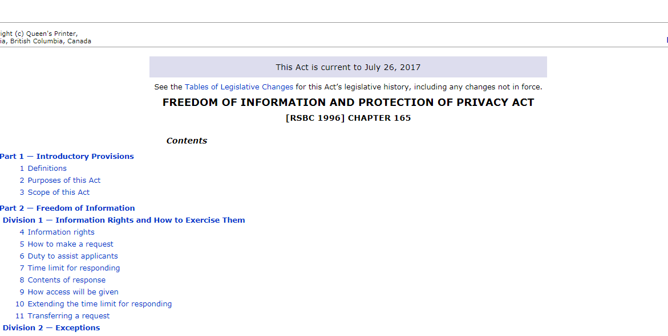
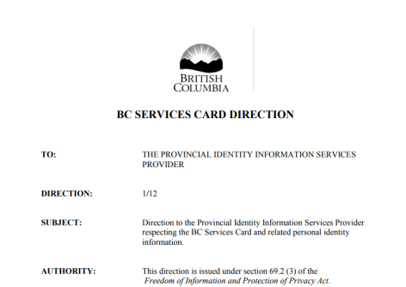

1. Communication/ Collaboration
Identity 101
Evolve from telling what we’ve done
To sharing why this is important and what you get if it’s done well
Notes:
Jackie

Slide 6

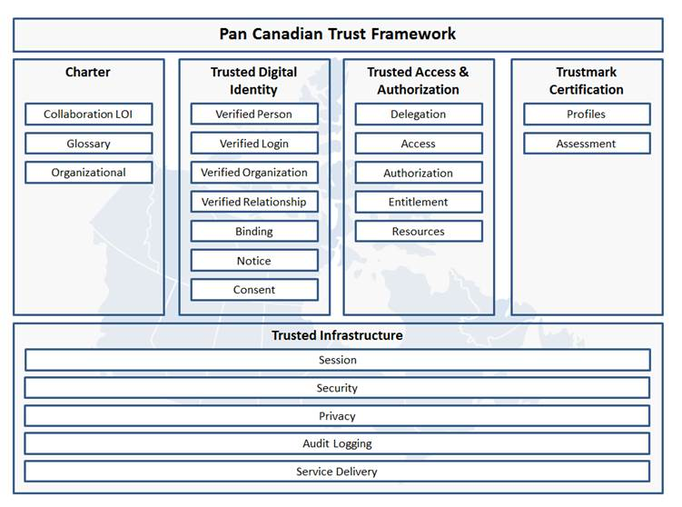
2. Pan-Canadian Trust Framework
Legend
Complete
First Draft
Draft Starting
Notes:
Ian

Slide 7

2. “Alpha Testing” of PCTF Conformance Criteria
Verified Person “Alpha Testing” (Fall 2017 – Winter 2018)
Alpha involves validation of Verified Person component by program areas.
What does this mean for Business Owners / Program Delivery Managers?
Opportunity to provide concrete feedback
Develop a common understanding of similar processes carried out in different places
Inform the development and practical application of the trust framework (pilots)
Use as feedback for service design/digital transformation initiatives.
Sept 2017
Identify Leads in Jurisdictions
Oct 2017
Develop Mapping/ Assessment Tool
Jan 2018
Perform Mapping & Assessment
Feb 2018
Prepare of Alpha Test Report
Finalize Recommendation Draft of Verified Person Component & Criteria
Notes:
Ian Presents
(Rita will be on phone)
The first draft component to be tested out by the jurisdictions will be the Verified Person component.
This process is called “Alpha Testing” and will involve validation of the Verified Person component by program areas in jurisdictions.
They will be asked to test out the standards for alignment with their own processes/standards, provide feedback and revisions to the standards as required.
This process will also highlight what guidance and interpretation support is needed for the standard.
The process will present an opportunity to:
Provide tangible and concrete feedback
Develop a common understanding of similar processes carried out in different programs/ jurisdictions
Inform the development and practical application of the trust framework (pilots)
Map similar processes carried out in different programs and jurisdictions in relation to the application of the trust framework
Use lessons learned to inform service design, digital transformation initiatives, etc.

Slide 8





3. Pilots
4 types
a. Testing out trust framework / standards
b. Supporting Client Centric Service Delivery
c. Testing inter-jurisdictional governance/policy processes
d. Testing existing and emerging technologies
Notes:
Jackie

Slide 9

3a. Pilots: Testing out the Trust Framework
Relation-ships
Person
Organization
Notes:
Ian

Slide 10

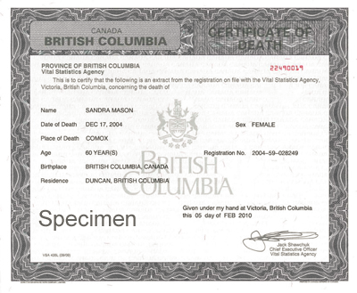
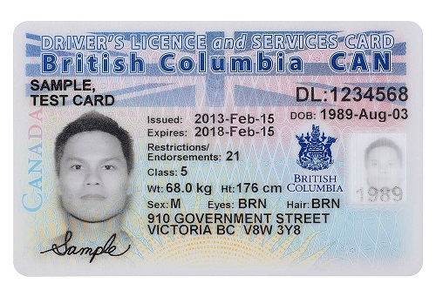
3b. Pilots: Supporting Client Centric Services
Notes:
Ian

Slide 11

Status Update
3c. Canada’s Digital Interchange (CDI):
Testing inter-jurisdictional governance/policy processes
Notes:
CDI – Rob Presents

Slide 12
3c. Nova Scotia (NS) Pilot
The NS pilot includes two components:
Component 1: NS to validate client identity information against the Social Insurance Registry (SIR) for selected NS programs, enabling instant registration with the required Level of Assurance to the NS Login System.
Component 2: ESDC to validate client identity information against NS’ Vital Statistics Office (VSO) database, enabling instant registration to My Service Canada Account (MSCA).
Currently pursuing required authorities and assessing privacy impacts.
Alberta (AB) Pilot
This pilot will provide Alberta students with the ability to access the federal Canada Student Loans Program (CSLP) using their MyAlberta Digital ID/Verify without having to create a new (federal) identity credential.
Currently assessing the MyAlberta Digital ID/Verify credential against the Pan-Canadian Trust Framework standards.
Notes:
CDI – Rob/Jackie/Arlene Present

Slide 13
3d. Government of Canada Interoperability Platform as Enabler to CDI
A Single Service Point for Vital Events and Identity Digital Services
An Established technology
Secure and reliable
Provides Translation
Standardizes message formats and provides support for legacy formats
Is Adaptable
Adjusts to the needs of partners
Guarantees Traceability
Ensures that all transactions are tracked and reportable to parties involved in the transaction
*
Notes:
CDI – Rob presents

Slide 14
3cd. Alignment of CDI to Identity Management Priority
The CDI pilots will:
Demonstrate the business value of CDI between interjurisdictional levels of government;
Advance key CDI design elements;
Test elements of the Pan-Canadian Trust Framework; and
Improve client service delivery.
Notes:
CDI – Rob presents

Slide 15




4. Approach to Technology
Notes:
Jackie

Slide 16


5. Public Policy & Governance
Notes:
Ian

Slide 17
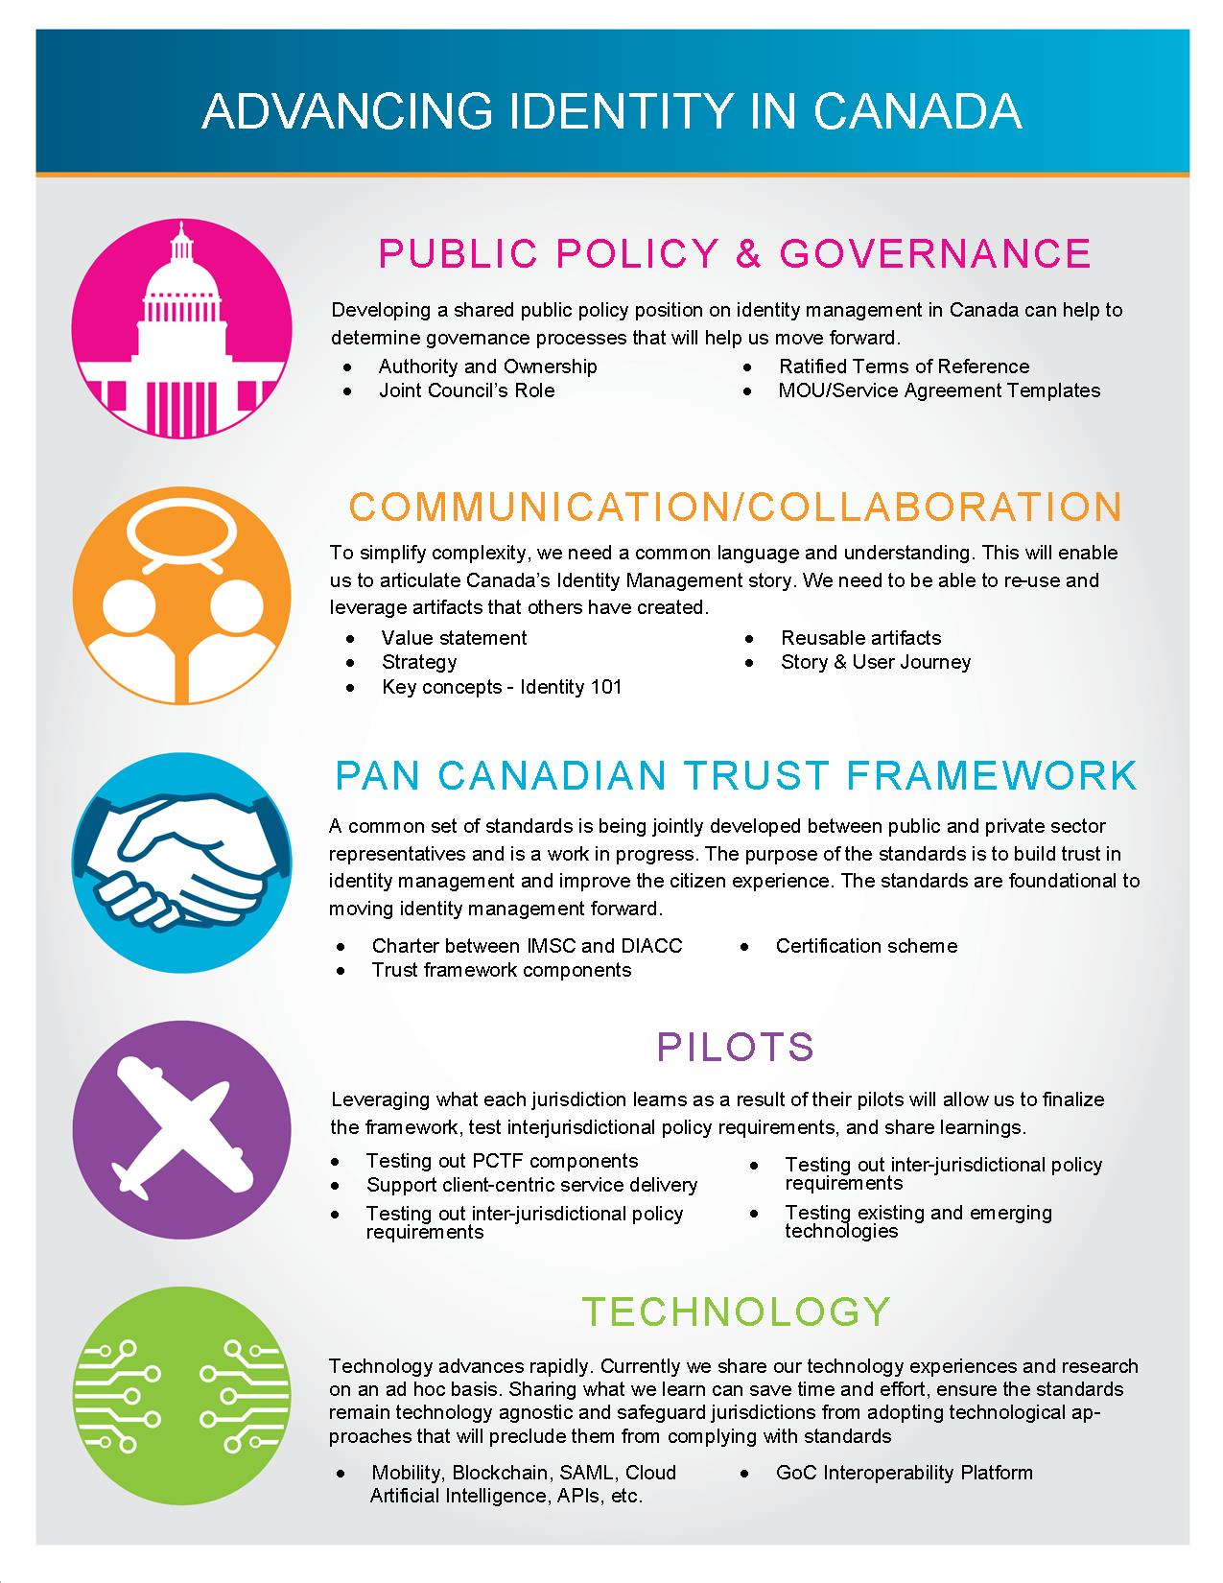







What is our current approach to collaboration?
Jurisdiction to Jurisdiction
Pan-Canadian Collaboration
/
What do we need to do to act on these key findings together ?
Notes:
Jackie

Slide 18
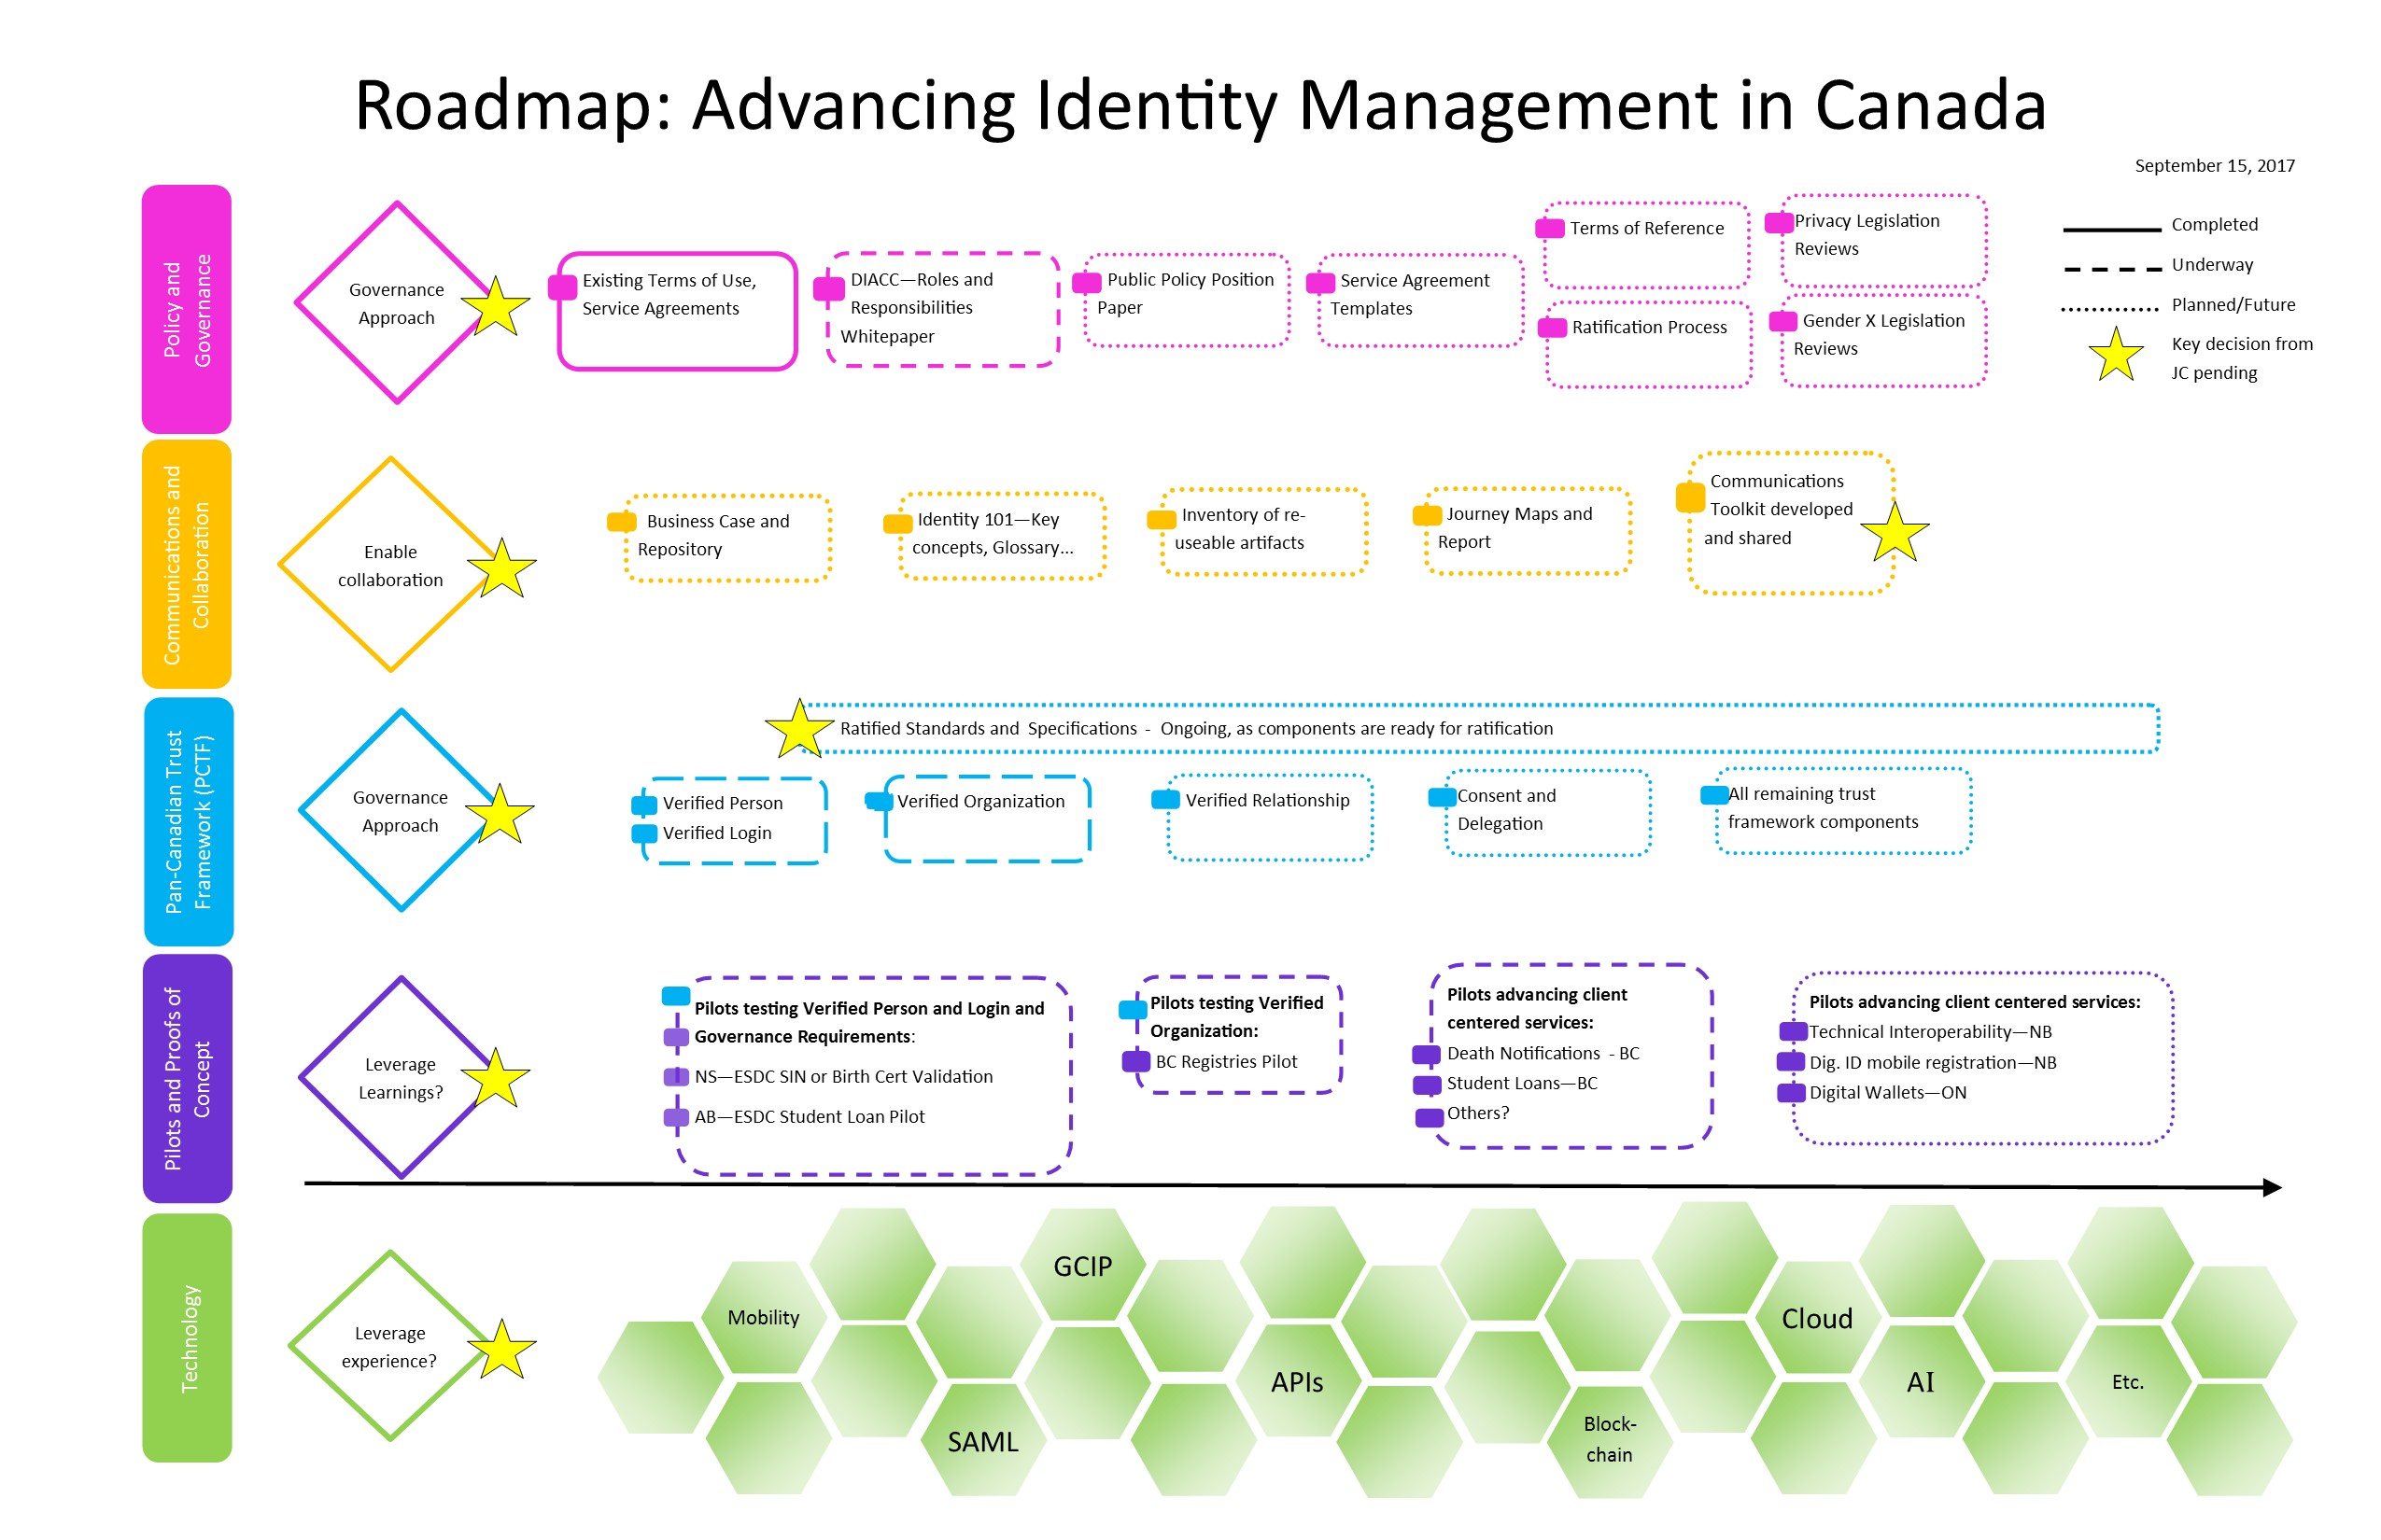
Notes:
Jackie

Slide 19
Key Questions & Recommendations
Decisions needed to advance identity management
Notes:
Jackie

Slide 20
Q: Public Policy & Governance
We need to develop a pan-Canadian public policy position.
If Joint Council agrees, what resources/funding are available to develop?
Who are our stakeholders?
Who will champion?
The public policy findings can inform the most appropriate approvals/decision-making processes and address the Q:
How do we ensure this work is governed in a way that aligns with Joint Council and jurisdictions’ goals?
Notes:
Ian

Slide 21
Q: Communication/
Collaboration
Do you want us to develop a Communication toolkit?
What do you want to see included as deliverables?
Identity 101 (basic identity concepts)?
Canada’s Identity Story?
Impacts of different approaches to identity management?
Maintained “Advancing Identity Management Roadmap”
If so, what resources are available to develop it?
Who will champion?
Within what timeline do you expect it to be delivered?
Notes:
Jackie

Slide 22
Q: Pilots
Are you committed to sharing information about the pilots you are doing?
Do we agree that pilots help advance the development of the other streams we’ve discussed?
If so, what resources are available to formalize a feedback loop to share what we learn?
Who will champion?
Do PTs want to exchange identity information between themselves through a common hub? If so, does the hub need to have shared governance?
How can we ensure ongoing alignment between PT identity management priorities and CDI?
Q: Advancing CDI
Notes:
Jackie/Rob

Slide 23
Q: Technology
Is sharing information on technological advancements valuable?
Are you committed to sharing information about the technology you are using?
Is it important that these be included in the roadmap?
If so, how and how often should we share what we learn?
Who will champion?
Notes:
Jackie

Slide 24
Thank you!

